Slide 1
Toward Full-System Heterogeneous Simulation: Merging gem5-SALAM with Mainline gem5
Akanksha Chaudhari and Matthew D. Sinclair
University of Wisconsin-Madison
sinclair@cs.wisc.edu
Notes:
ADD OUTLINE SLIDES

Slide 2
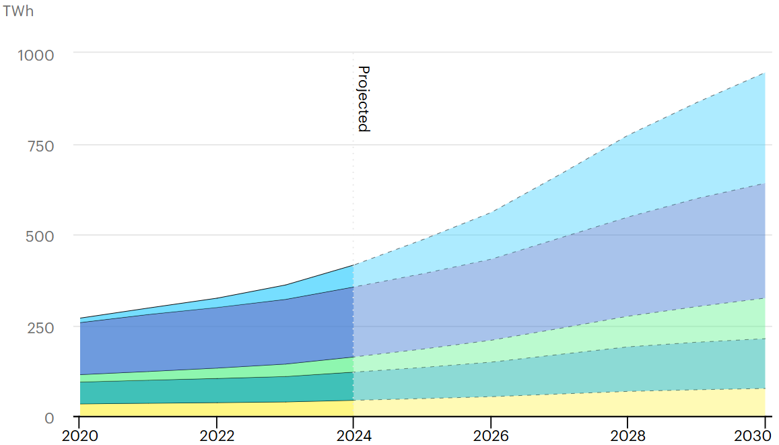
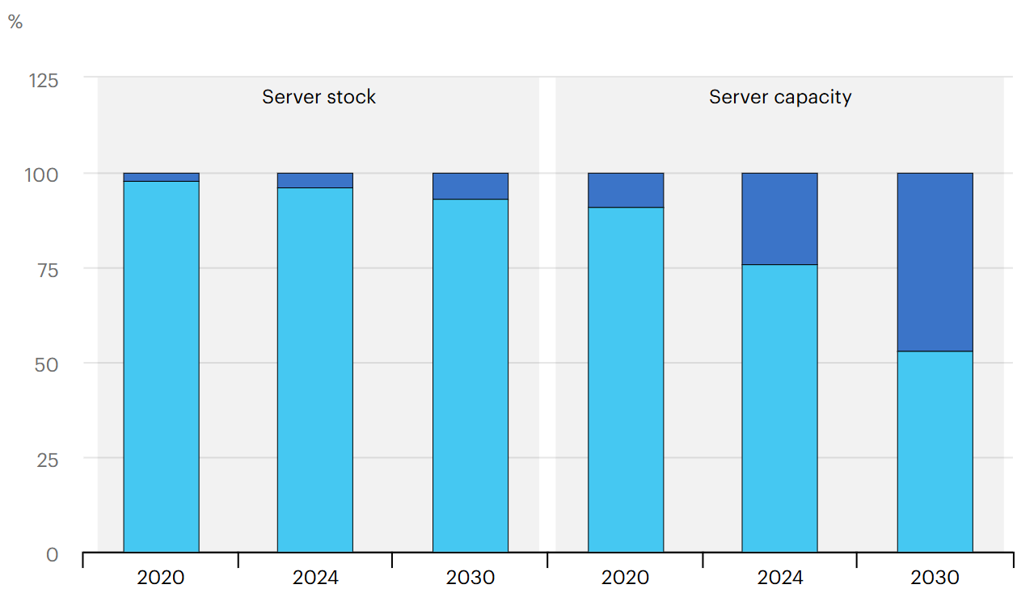
Global Datacenter Electricity Consumption
Escalating Power Demands: Datacenter electricity consumption expected to triple by 2030, with accel-rich servers driving majority of the growth.
Shift toward heterogeneity: By 2030, accelerated servers are projected to deliver ~50% of total compute while comprising <10% of server stock
2
Source: IEA (2025), Energy and AI, IEA, Paris https://www.iea.org/reports/energy-and-ai, License: CC BY 4.0

Slide 3
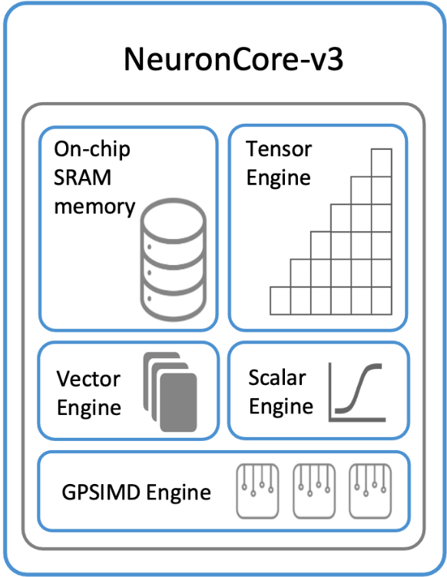
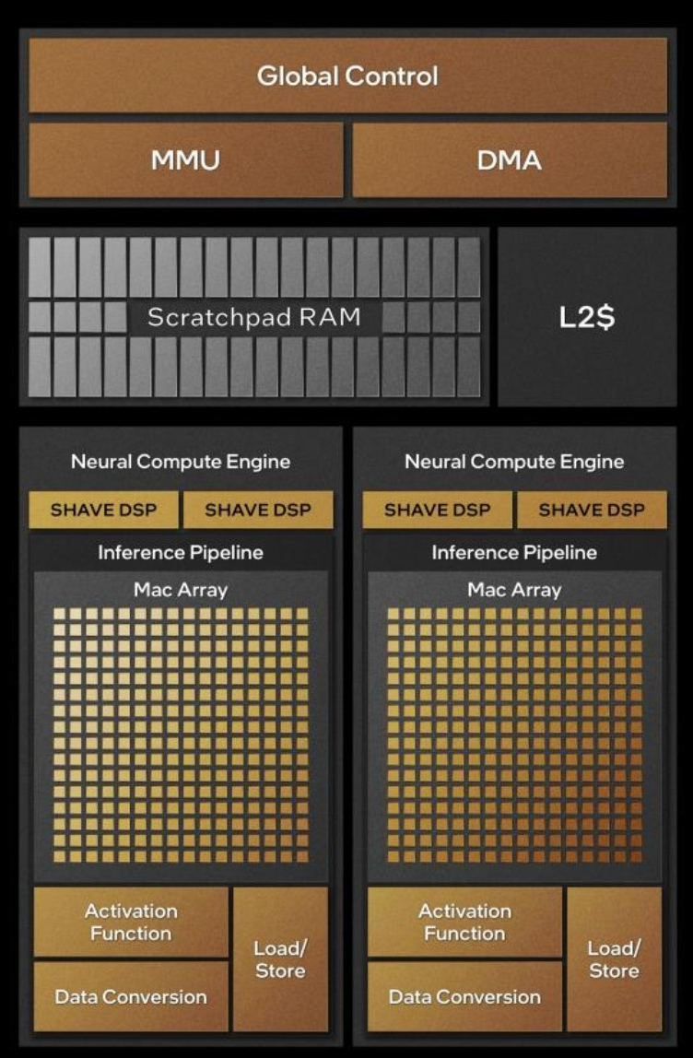
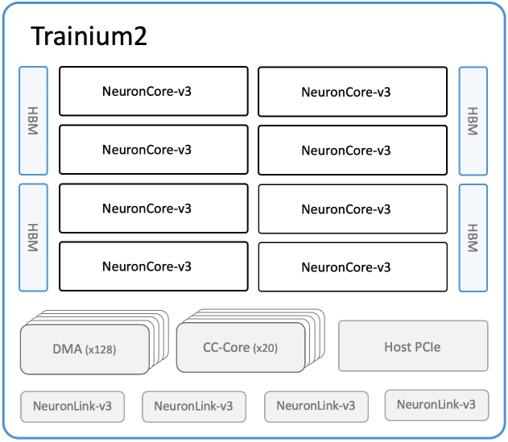
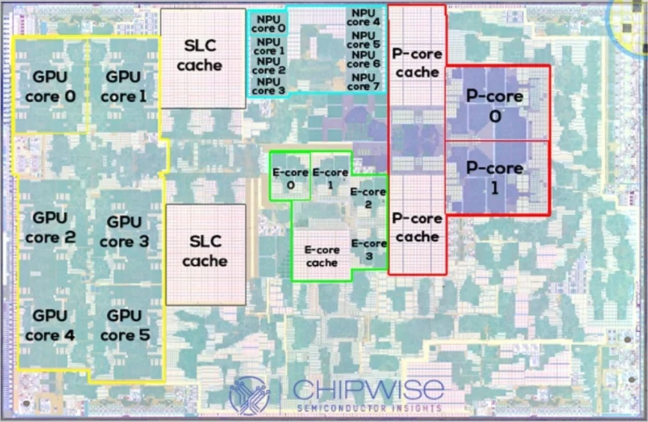
Heterogeneity is the New Norm
AWS Trainium2 NeuronCore-v3
Servers
Intel Meteor Lake
Laptops
Apple A15 Bionic
Phones/Tablets
3
Sources: AWS Docs Neuron, Intel Tech Tour, Chipwise
Notes:
Die Shot for Visuals?? Venn diagram / triangular flow??
Next-generation computing systems are increasingly heterogeneous
CPUs, GPUs, and domain-specific accelerators integrated at scale
https://awsdocs-neuron.readthedocs-hosted.com/en/latest/general/arch/neuron-hardware/trainium2.html
https://cdrdv2-public.intel.com/

Slide 4
Heterogeneity is the New Norm
Increasingly complex designs!
Non-trivial power/perf characteristics
Memory-compute co-optimization
AWS Trainium2 NeuronCore-v3
Servers
Intel Meteor Lake
Laptops
Apple A15 Bionic
Phones/Tablets
4
Sources: AWS Docs Neuron, Intel Tech Tour, Chipwise

Slide 5
Designing for Heterogeneity: What is Needed?
Cross-layer observability to guide early-stage co-optimization
Full-system context including memory hierarchy and software stack
Validated, cycle-level simulation of all components
5

Slide 6
The Simulation Gap
Simulator | CPU | GPU | Accelerators | FS Support
gem5 (v25) - SOTA | ✔ | ✔ | ✗ | ✔
SALAM | ✗ | ✗ | ✔ | ✗
6
Notes:
Add the table from poster

Slide 7
The Simulation Gap
Simulator | CPU | GPU | Accelerators | FS Support
gem5 (v25) - SOTA | ✔ | ✔ | ✗ | ✔
SALAM | ✗ | ✗ | ✔ | ✗
No unified framework for simulating heterogeneous SoCs within the full-system context
7
Notes:
Add the table from poster

Slide 8
The Simulation Gap
Simulator | CPU | GPU | Accelerators | FS Support
gem5 (v25) - SOTA | ✔ | ✔ | ✗ | ✔
SALAM | ✗ | ✗ | ✔ | ✗
gem5-SALAM | ✔ | ✔ | ✔ | ✔
This work: unify head of gem5, gem5-SALAM
Enables unified simulation of CPUs, GPUs, and accelerators
8
Notes:
We integrate SALAM’s accelerator modeling capabilities into the gem5 mainline (v24)Unify simulation of CPUs, GPUs, and accelerators under a single framework
gem5 provides detailed CPU modeling and now supports full-system GPU simulation; however, accelerator modeling remains fragmented.
gem5-SALAM enables LLVM-based accelerator simulation atop gem5 v21.1:
Operates outside the gem5 mainline.
Restricts modeling to standalone accelerators.
Cannot utilize recent gem5 features
(e.g., GPU integration, memory system improvements).
To bridge this gap, we integrate gem5-SALAM into mainline gem5, enabling tightly coupled, full-system simulation of heterogeneous systems consisting of CPUs, GPUs, and accelerators within a unified framework.

Slide 9
Outline
Introduction
Background
Integration Methodology
Frequency Scaling Study
Results and Analysis
Conclusions and Future Work
9

Slide 10
Integration Overview
gem5 develop-v25
SALAM Accelerator Simulation Models
10
Notes:
Integration effort focused on three key dimensions:
Incorporating SALAM’s simulation components and memory abstractions
Aligning interfaces with gem5’s current software architecture
Validating correctness through regression testing and comparing functional equivalence

Slide 11
Integration Overview
gem5 develop-v25
SALAM Accelerator Simulation Models
Incorporating key Accelerator Modeling and Communication Components
11

Slide 12
Integration Overview
gem5 develop-v25
SALAM Accelerator Simulation Models
Incorporating key Accelerator Modeling and Communication Components
Refactoring and Aligning Interfaces
12

Slide 13
Integration Overview
gem5 develop-v25
SALAM Accelerator Simulation Models
Incorporating key Accelerator Modeling and Communication Components
Refactoring and Aligning Interfaces
Validating Functional Equivalence
13

Slide 14
Methodology: Incorporating SALAM Components
LLVMInterface: Enables cycle-level datapath simulation via runtime IR parsing.
CommInterface: Exposes accelerators via memory-mapped registers and programmable interrupts.
Memory Models (SPMs, DMAs, etc): For low-latency access, data movement, and streaming.
AccCluster: Groups accelerators, local memories, and DMAs into modular subsystems.
Hardware Profile Generator: Extended the toolchain to fully automate the generation of functional units and instruction timing models from user-defined profiles.
Cacti-SALAM Power Models: Modernized the framework to support energy and timing estimation via config files for SPMs
14

Slide 15
Methodology: Refactoring and Aligning Interfaces
SimObject Alignment: Refactored accelerator classes to conform with gem5’s latest SimObject conventions, ensuring proper initialization and parameter declaration structures.
Type-safety Fixes: Replaced unsafe pointer casts in LLVM instruction simulation with intermediate 32-bit variables. This resolved array bounds and strict aliasing warnings during bitcasting.
Latency Generation Standardization: Migrated custom random latency utilities to gem5’s standardized random number generation framework for reproducibility and consistency.
Address Range Corrections: Fixed off-by-one errors in address range definitions for scratchpad and register bank modules to follow gem5’s inclusive-exclusive address semantics.
Environment and ISA Configuration Updates: Updated build environment handling to align with gem5’s latest ISA-specific configuration mechanism, resolving prior compatibility issues.
Build System Integration for LLVM: Added dynamic LLVM configuration via llvm-config to gem5’s SCons build system, enabling seamless compilation and linking for datapath simulation
15

Slide 16
Methodology: Validating Functional Equivalence
Validated outputs and confirmed functional equivalence
Ensured compliance with gem5’s pre-commit and full regression test suite
Adapted SALAM’s system validation tests; cross-validated outputs against baseline to confirm functional equivalence
16
Notes:
More specifics for first two bullet points.

Slide 17
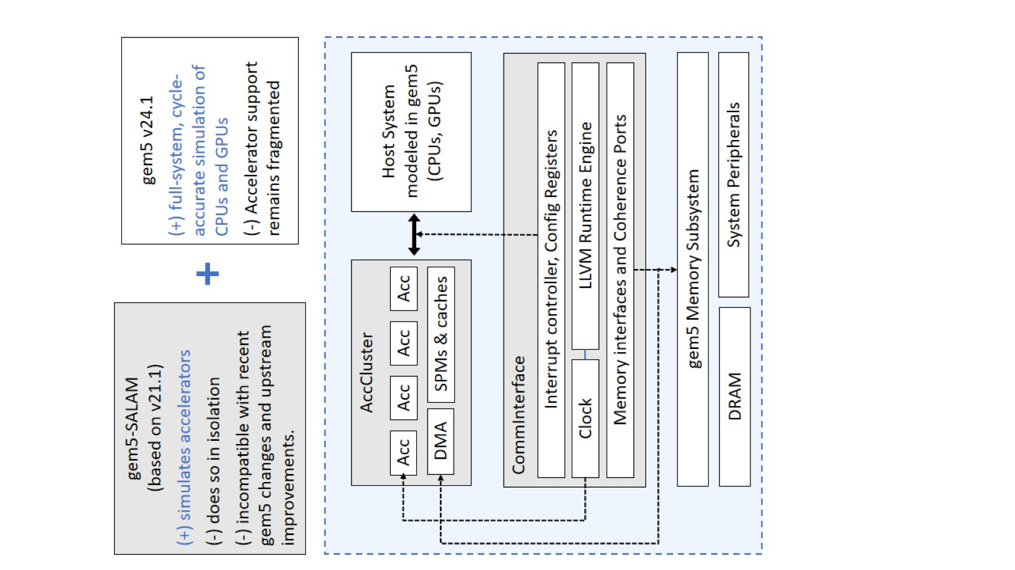
The Integrated Framework: What it Enables
Broader heterogeneity studies
Co-simulate CPUs, GPUs, and custom accelerators.
Realistic modeling of heterogeneous systems with diverse compute elements and interactions.
System-level exploration
Compare static vs dynamic accelerator scheduling, shared vs private local memories.
Evaluate placement, offloading, and sync strategies.
Domain-specific workload support
Use built-in benchmark suite for architectural studies.
Model and study new workloads of interest.
17

Slide 18
Modeling and Simulating an Accelerator
C/C++ Functional Description of Acc. System
LLVM Intermediate Representation
18

Slide 19
Modeling and Simulating an Accelerator
System-level Description (AccCluster, DMA, SPM)
C/C++ Functional Description of Acc. System
LLVM Intermediate Representation
Hardware Profile Generated at Design Time
19

Slide 20
Modeling and Simulating an Accelerator
System-level Description (AccCluster, DMA, SPM)
Host-side Program that launches and monitors the Acc.
C/C++ Functional Description of Acc. System
LLVM Intermediate Representation
Hardware Profile Generated at Design Time
20

Slide 21
Modeling and Simulating an Accelerator
System-level Description (AccCluster, DMA, SPM)
Host-side Program that launches and monitors the Acc.
C/C++ Functional Description of Acc. System
LLVM Intermediate Representation
Host-Accelerator System Model
Hardware Profile Generated at Design Time
21

Slide 22
Modeling and Simulating an Accelerator
System-level Description (AccCluster, DMA, SPM)
Host-side Program that launches and monitors the Acc.
C/C++ Functional Description of Acc. System
LLVM Intermediate Representation
Host-Accelerator System Model
Simulate using run_system.sh
m5out/stats.txt Cycle counts, cache stats, DMA traffic etc.
Hardware Profile Generated at Design Time
m5out/SALAM_power.csv Energy area breakdown if Cacti-SALAM is run
m5out/system.terminal Console prints from the host software
22

Slide 23
Outline
Introduction
Background
Integration Methodology
Frequency Scaling Study
Results and Analysis
Conclusions and Future Work
23

Slide 24
Case Study: Extreme Frequency Scaling
Prior studies suggest accelerators are viable candidates for many GHz-scale execution
Advanced cooling enables transient high-frequency operation (“computational sprinting”).
24
Source: Raghavan et al, HPCA 2012

Slide 25
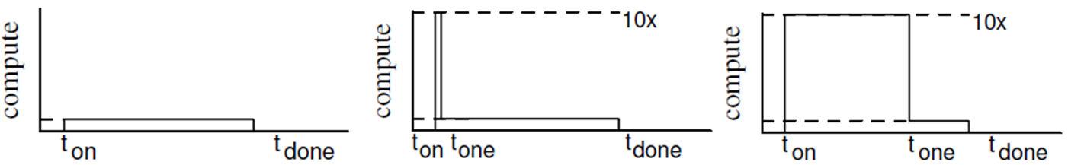
Case Study: Extreme Frequency Scaling
Prior studies suggest accelerators are viable candidates for multi GHz-scale execution
Advanced cooling enables transient high-frequency operation (“computational sprinting”).
Exceeds TDP; cannot be sustained for too long. No meaningful work completed
Normal Mode Operation
High-Frequency Operation
25
Source: Raghavan et al, HPCA 2012

Slide 26
Case Study: Extreme Frequency Scaling
Prior studies suggest accelerators are viable candidates for multi GHz-scale execution
Advanced cooling enables transient high-frequency operation (“computational sprinting”).
Normal Mode Operation
High-Frequency Operation
Cooled High-Frequency Operation
Cooling allows for longer “sprints” – making them actually beneficial
26
Source: Raghavan et al, HPCA 2012

Slide 27
Case Study: Extreme Frequency Scaling
Prior studies suggest accelerators are viable candidates for multi GHz-scale execution
Advanced cooling enables transient high-frequency operation (“computational sprinting”).
Use the integrated framework to evaluate accelerator performance up to 20 GHz
Normal Mode Operation
High-Frequency Operation
Cooled High-Frequency Operation
27
Source: Raghavan et al, HPCA 2012

Slide 28
Methodology
Limit study to examine upper bound on performance and energy efficiency gains
Use small test inputs, configured to fit in accelerator scratchpad.
Isolates compute, eliminating any memory and interconnect bottlenecks
Simulator Changes: Refined timing logic in LLVM Runtime, DMA, and interfaces to enable sub-cycle event resolution.
Single accelerator instantiated with ARM DerivO3 CPU as host system.
Sweep accelerator frequency from 0.1 to 20 GHz.
Simulate MachSuite kernels to measure:
Runtime for Performance
Dynamic Power for Energy Efficiency
28

Slide 29
Outline
Introduction
Background
Integration Methodology
Frequency Scaling Study
Results and Analysis
Conclusions and Future Work
29
Notes:
Die Shot for Visuals?? Venn diagram / triangular flow??

Slide 30
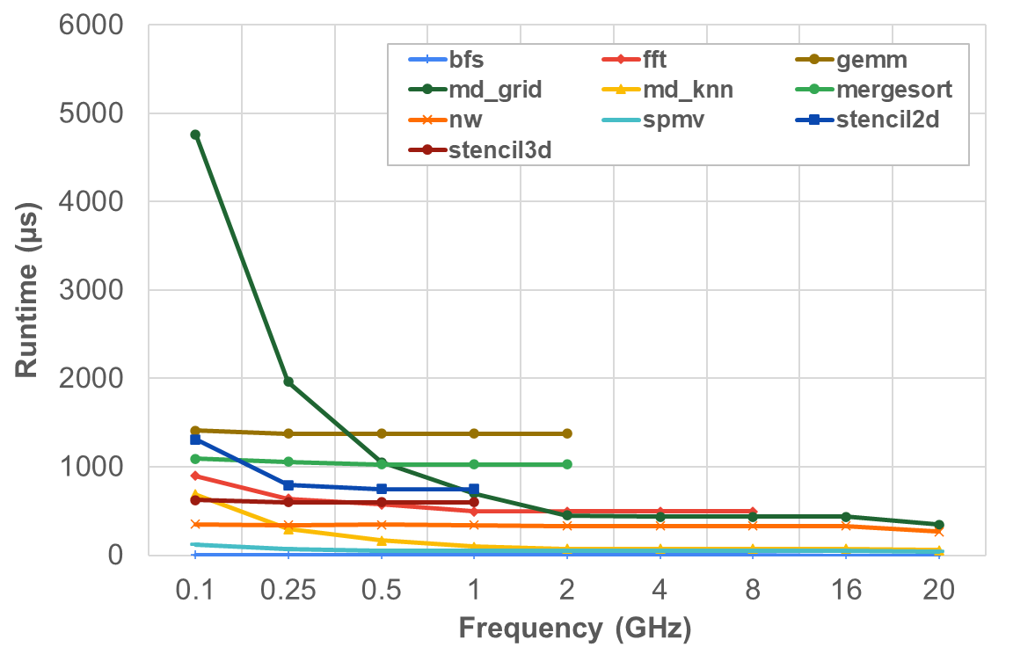
Preliminary Results: Performance
0.1 – 2 GHz: Perf. is compute-bound, frequency helps.
Small input sizes limit utilization for some benchmarks, reducing observable gains
2 – 20 GHz: Performance plateaus
Bottlenecks shift to CPU and DMA latency.
Takeaway: Benefits of frequency scaling can be limited by both underutilization and system-level bottlenecks.
30
Notes:
Small input sizes limit utilization for some benchmarks, reducing observable gains

Slide 31
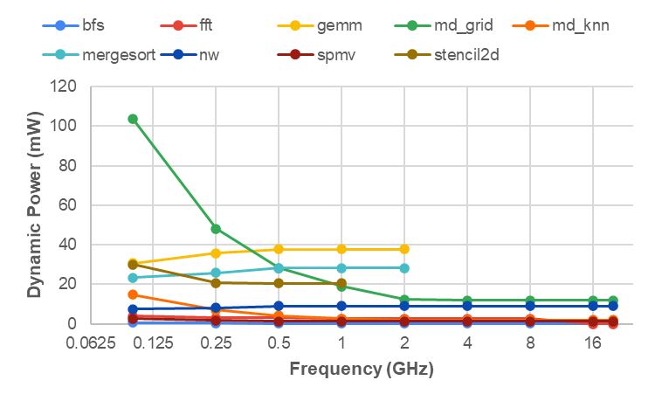
Preliminary Results: Dynamic Power
0.1 – 2 GHz: Power shaped by active time reduction
Compute-bound kernels: Power decreases as faster execution shortens active duration; idle time dominates the average.
Others: Power stable/slightly rising; active time is non-negligible.
2 – 20 GHz: Power converges across all benchmarks
Active time becomes negligible, idle state dominates.
Takeaway: Time-averaged power scaling is limited by shorter active phases and increasing idle time at higher frequencies.
31

Slide 32
Outline
Introduction
Background
Integration Methodology
Frequency Scaling Study
Results and Analysis
Conclusions and Future Work
32
Notes:
Die Shot for Visuals?? Venn diagram / triangular flow??

Slide 33
Conclusions and Future Work
Modern and future systems increasingly embracing heterogeneity
But tools are struggling to keep pace with the needs of these heterogeneous systems
Solution: create unified full-system simulation framework for heterogeneous SoCs
Case Study: high-frequency simulation for accelerators → shows promise
Integrating support into gem5 mainline (on-going)
Benchmark suite expansion
Add domain-specific workloads of interest to the SALAM resource set
Multi-ISA enablement
Extend full-system support beyond ARM:
Route accelerator interrupts through ISA-specific interrupt controllers
Core-Local Interrupt Controller (CLIC) for RISC-V (working with NKAU)
Validate boot flow and benchmark functionality for new ISA
33

Slide 34
Backup

Slide 35
High-Frequency Acceleration Studies
Advanced cooling enhances efficiency by enabling higher operating frequencies.
Cooling technology | Viable core-clock domain | Indicative perf/W gain
Air (direct-evaporative) | ≤ 3 – 4 GHz | 1 × (baseline)
Single-phase immersion | ≈ 6 – 8 GHz | ≈ 1.3 – 1.6 ×
Two-phase immersion | ≥ 8 GHz | ≈ 1.6 – 1.7 ×
Cryogenic (≤ 77K LN₂ / ≤ 4K LHe) | > 10 GHz | > 100 × (device energy)
* Datacenter-level data from Microsoft/OCP, IEEE Micro, Upsite, LiquidStack; device-level data for cryogenic from Imec.
35

